Slide 1

Tensorflow tutorial
Yoon-gu Hwang
Yonsei University

Slide 2

Tensorflow?
TensorFlow was originally developed by the Google Brain team for Google's research and production purposes
TensorFlow is Google Brain's second generation machine learning syste
Under the Apache 2.0 open source license on November 9, 2015

Slide 3
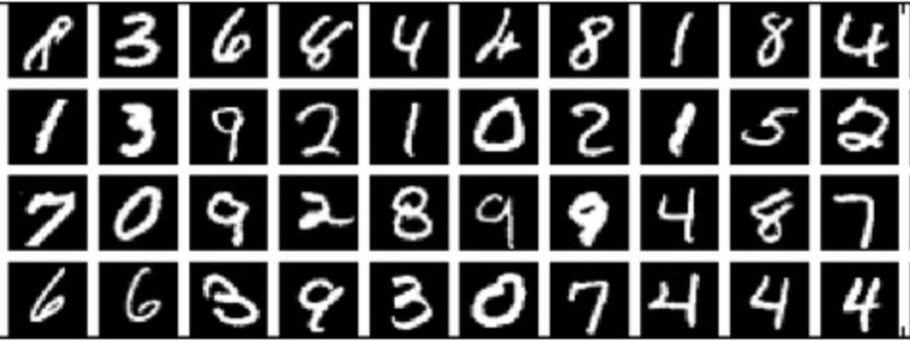
Mnist dataset

Slide 4
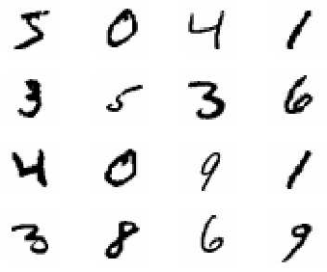
MNIST?
Mixed National Institute of Standards and Technology database
Handwritten Digits
55,000 training images
10,000 test images
28 x 28 images
28
28

Slide 5
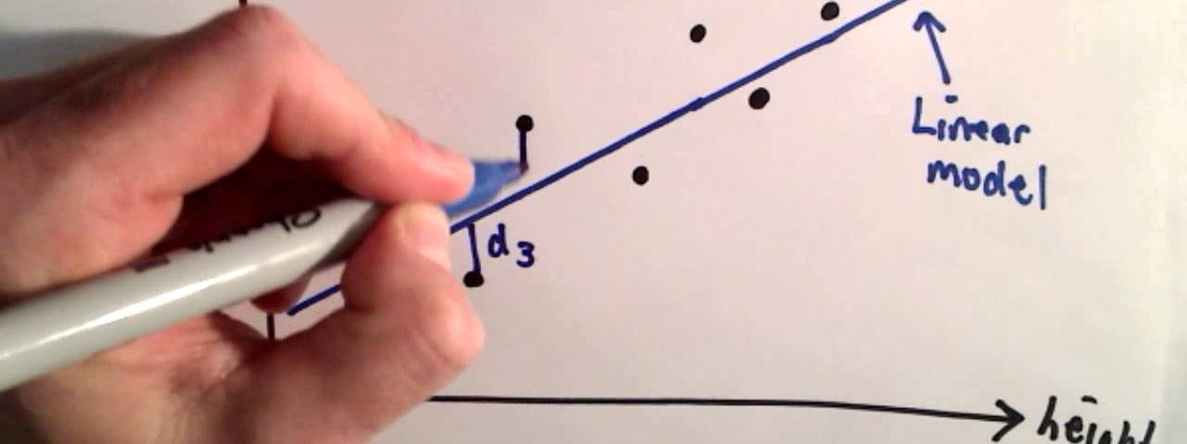
Linear regression

Slide 6
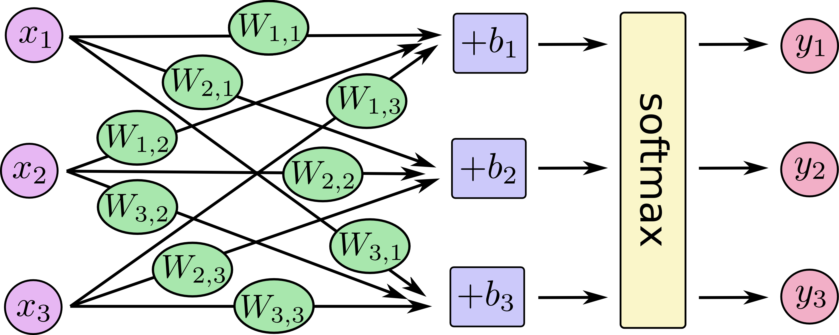

Slide 7
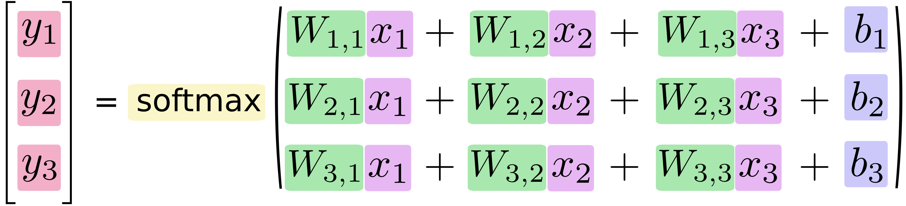

Slide 8
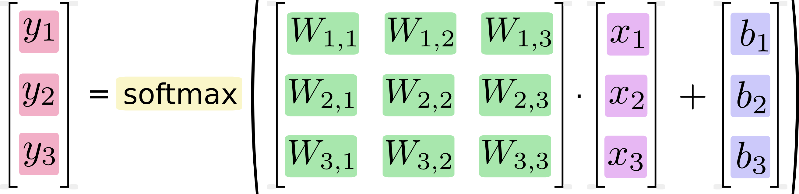

Slide 9
Variable types
x = tf.placeholder(…)
W = tf.Variable(…)
b = tf.Variable(…)
y = tf.nn.softmax(tf.matmul(x, W) + b)

Slide 10
Linear regression
Demo
https://github.com/yoon-gu/tensorflow-tutorial

Slide 11
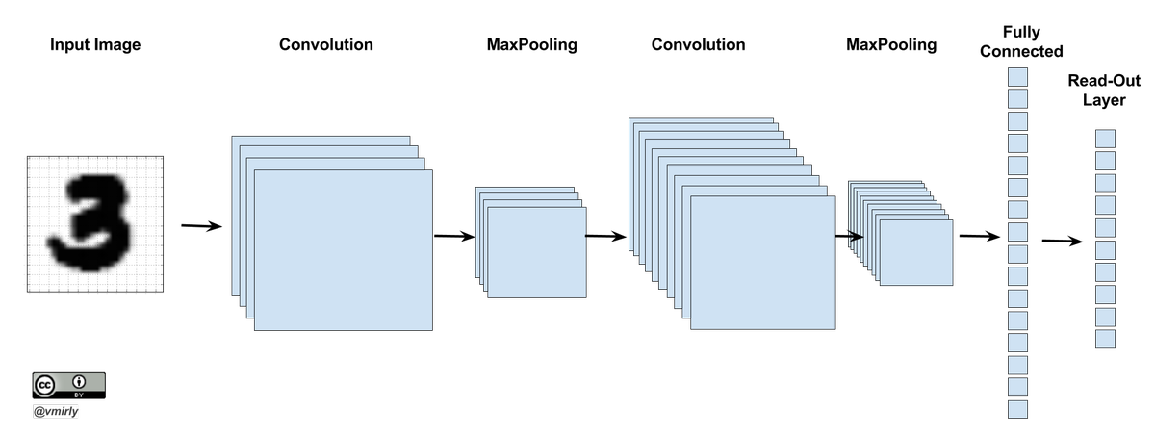
Convolutionary neural network

Slide 12
Before deep learning
Collect data
Feature Design
Feature Extraction
Machine Learning
We have to DESIGN filters to get features!

Slide 13
Feature extractions by Convolution
0 | 1 | 1 | 2 | 2 | 2 | 1 | 1 | 0
1 | 2 | 4 | 5 | 5 | 5 | 4 | 2 | 1
1 | 2 | 4 | 5 | 5 | 5 | 4 | 2 | 1
2 | 5 | 3 | 12 | 24 | 12 | 3 | 5 | 2
2 | 5 | 0 | 24 | 40 | 24 | 0 | 5 | 2
2 | 5 | 3 | 12 | 24 | 12 | 3 | 5 | 2
1 | 2 | 4 | 5 | 5 | 5 | 4 | 2 | 1
1 | 2 | 4 | 5 | 5 | 5 | 4 | 2 | 1
0 | 1 | 1 | 2 | 2 | 2 | 1 | 1 | 0
4 | 3 | 2 | 1 | 0 | -1 | -2 | -3 | -4
5 | 4 | 3 | 2 | 0 | -2 | -3 | -4 | -5
6 | 5 | 4 | 3 | 0 | -3 | -4 | -5 | -6
7 | 6 | 5 | 4 | 0 | -4 | -5 | -6 | -7
8 | 7 | 6 | 5 | 0 | -5 | -6 | -7 | -8
7 | 6 | 5 | 4 | 0 | -4 | -5 | -6 | -7
6 | 5 | 4 | 3 | 0 | -3 | -4 | -5 | -6
5 | 4 | 3 | 2 | 0 | -2 | -3 | -4 | -5
4 | 3 | 2 | 1 | 0 | -1 | -2 | -3 | -4
0 | 1 | 1 | 2 | 2 | 2 | 1 | 1 | 0
1 | 2 | 4 | 5 | 5 | 5 | 4 | 2 | 1
1 | 2 | 4 | 5 | 5 | 5 | 4 | 2 | 1
2 | 5 | 3 | -12 | -24 | -12 | 3 | 5 | 2
2 | 5 | 0 | -24 | -40 | -24 | 0 | 5 | 2
2 | 5 | 3 | -12 | -24 | -12 | 3 | 5 | 2
1 | 2 | 4 | 5 | 5 | 5 | 4 | 2 | 1
1 | 2 | 4 | 5 | 5 | 5 | 4 | 2 | 1
0 | 1 | 1 | 2 | 2 | 2 | 1 | 1 | 0
9
9
9
9

Slide 14
Example 1
Moving Average
Sobel
Laplacian

Slide 15
Example 2
Moving Average
Sobel
Laplacian

Slide 16
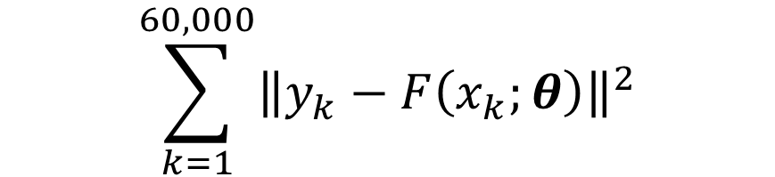
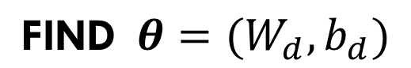
Optimization Problem 1
$$\text{FIND} θ=(W_{d},b_{d})$$
$$\sum_{k=1}^{60,000}{{\left\|y_{k}−F\left(x_{k};θ\right)\right\|}^{2}}$$
that MINIMIZE

Slide 17
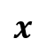

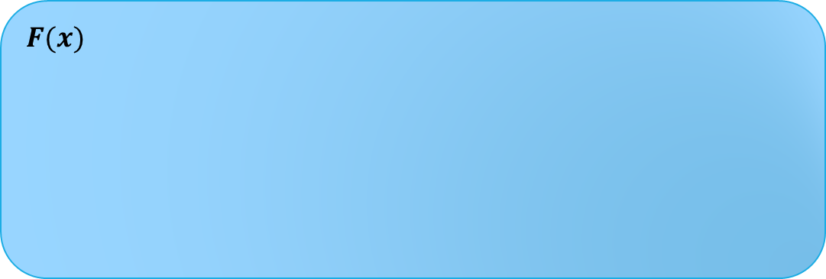
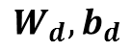

Flow
For given $W_{d}$ and $b_{d},$
$$F(x)$$
28x28
Feature Extraction
(Convolution)
Sigmoid
Pooling
Softmax
Image
$$x$$
Prob
$$y$$
$$W_{d}, b_{d}$$
[20x20] x 9
[20x20] x 9
[10x10] x 9
10 x 1

Slide 18
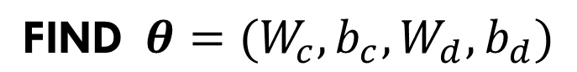
Optimization Problem 2
$$\text{FIND} θ={(W}_{c}, b_{c}, W_{d},b_{d})$$
$$\sum_{k=1}^{60,000}{{\left\|y_{k}−F\left(x_{k};θ\right)\right\|}^{2}}$$
that MINIMIZE

Slide 19

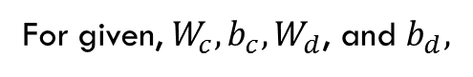
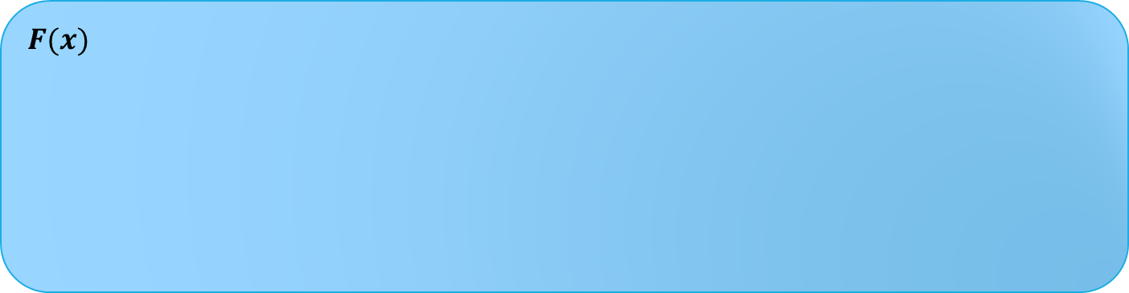
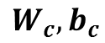
Flow
For given, $W_{c}, b_{c}, W_{d}$, and $b_{d},$
$$F(x)$$
28x28
Convolution
Sigmoid
Pooling
Softmax
Image
$$x$$
Prob
$$y$$
$$W_{c}, b_{c}$$
$$W_{d}, b_{d}$$
[20x20] x 9
[20x20] x 9
[10x10] x 9
10 x 1

Slide 20
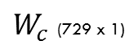
Parameter visualization
$W_{c}$ (729 x 1)
1st
9x9=81
9x9=81
2nd
9x9=81
8th
…
3rd
9th
9x9=81
9x9=81

Slide 21
CNN Demo
https://github.com/yoon-gu/tensorflow-tutorial

Slide 22
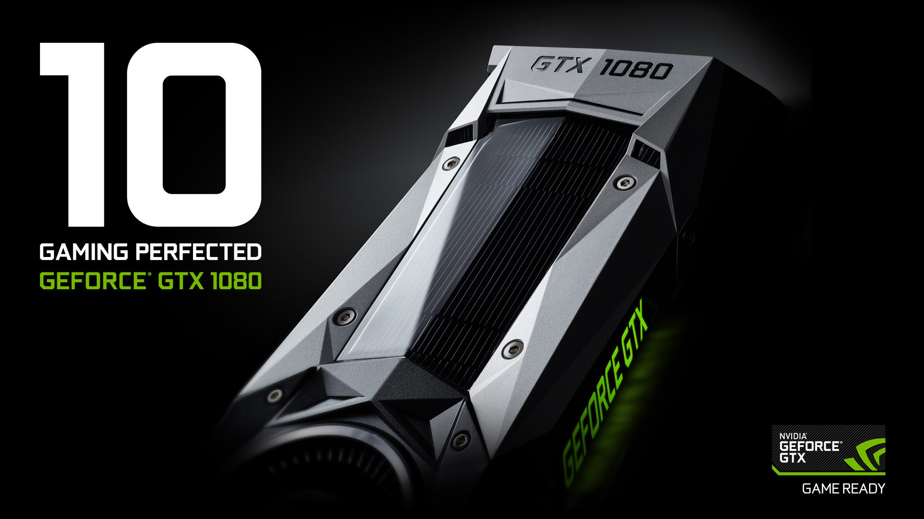
GPU Acceleration

Slide 23
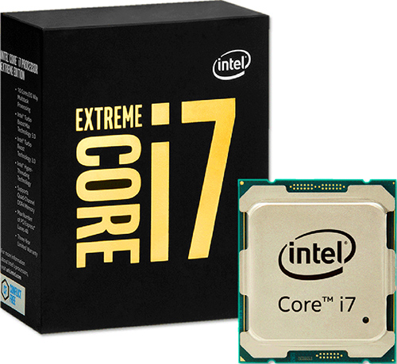
Performance
23 minutes VS 2 minutes
Intel® Core™ i7-6900K @ 3.20GHz
NVIDIA Geforce GTX 1080

Slide 24

Question?

